Slide 1
Kinco HMI Training
Kinco Automation

Slide 2
Contents
Ⅰ
Kinco HMI Profile
Ⅱ
Kinco HMIware Fast Start
Ⅲ
Main Function Introduction
Ⅳ
Advanced Function Introduction

Slide 3
Ⅰ. Kinco HMI Profile

Slide 4
Development of Kinco HMI
Kinco has developed 4 series HMIs to meet requirements of multiple applications.
MD200/300
MT4000
MT5000

Slide 5
Kinco HMI Production Line
Text Display | MT4000 Series | MT5000 Series | Customized models
MD204L MD214L MD224L MD304L | MT4210T MT4220TE MT4300C MT4300CE MT4404T MT4424TE MT4414T/TE MT4414TE-CAN MT4403T/TE MT4512T/TE MT4513T/TE MT4522T/TE MT4523T/TE MT4620TE | MT5320C MT5320C-DP/CAN/MPI MT5323T MT5323T-DP/CAN/MPI MT5423T MT5423T-DP/CAN/MPI MT5520T MT5520T-DP/CAN/MPI MT5620T MT5620T-DP/CAN/MPI MT5720T MT5720T-DP/CAN/MPI MT5700T | KG5300T KG5509T KM5303T F7/F10 CZ10
8-bit CPU. Low end application | 32-bit 800MHz RISC CPU, built-in USB slave. Mainstream application. | 32-bit 800MHz RISC CPU, built-in USB host, SD card port. High end application. | 32-bit 400MHZ RISC CPU. Special industries application.

Slide 6
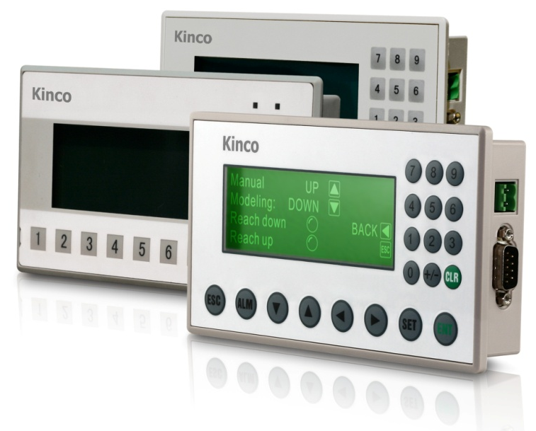
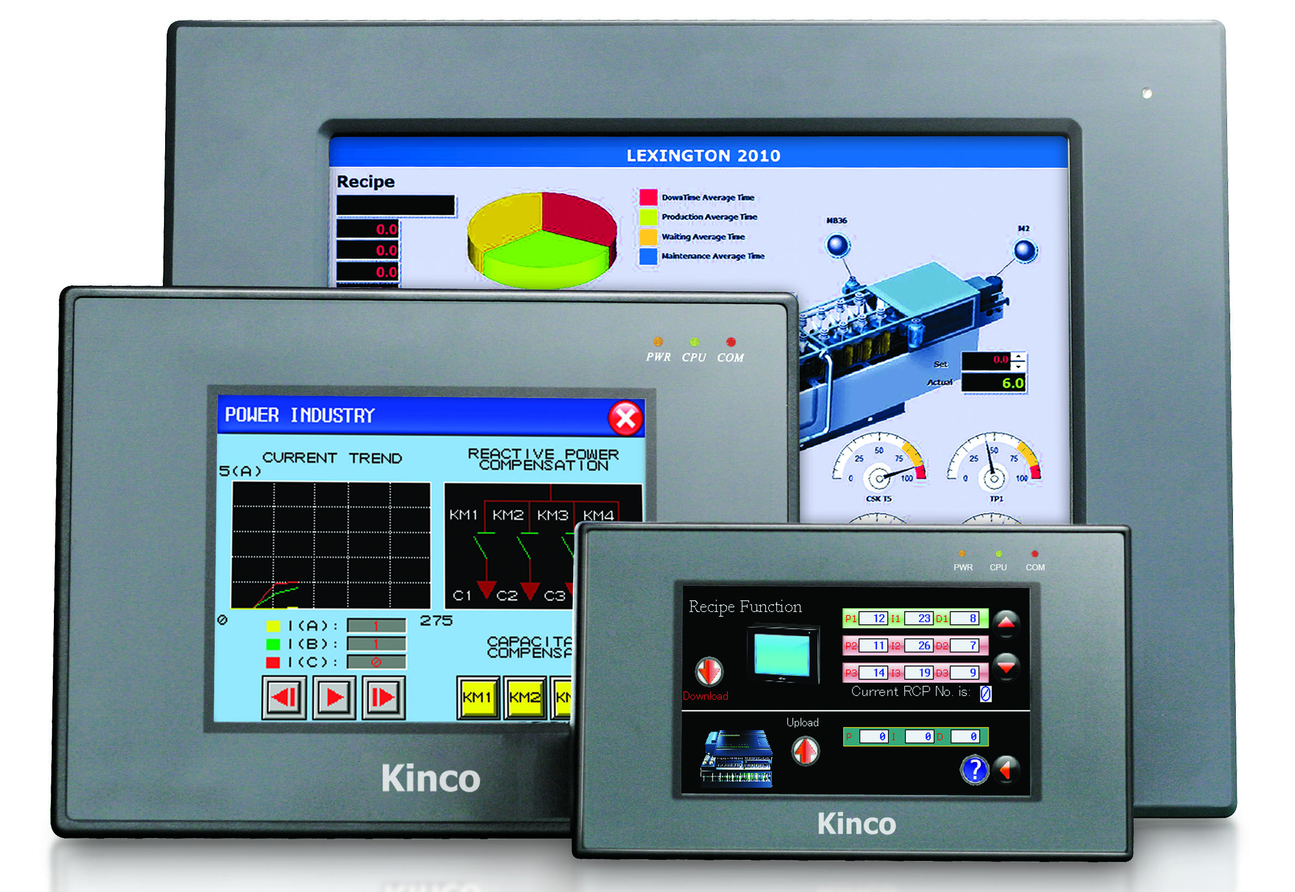
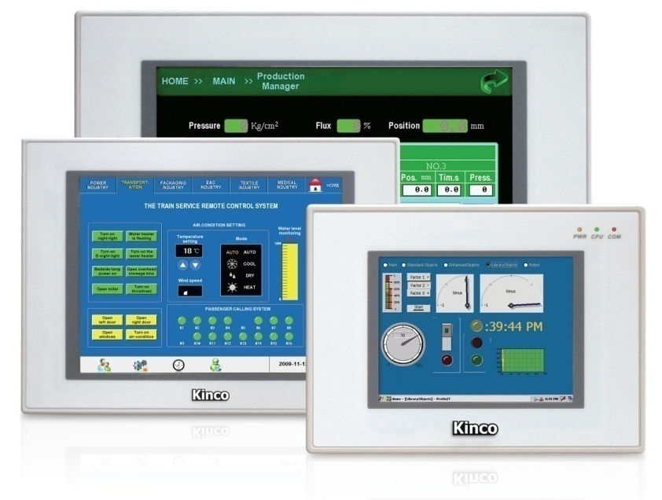
Kinco HMI Hardware
Text display
MT4000 series
MT5000 series

Slide 7
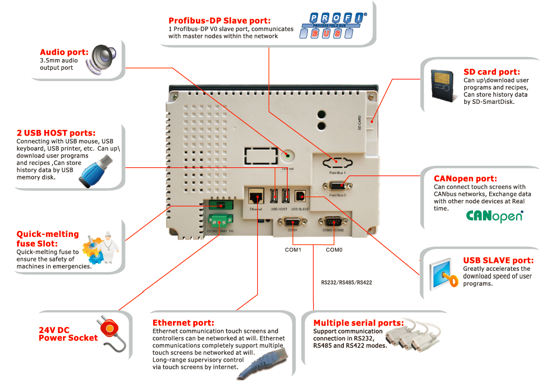
Interface Description

Slide 8
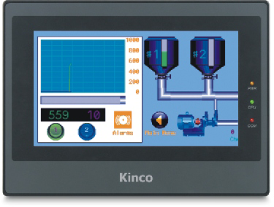
Kinco HMI Hardware-LED Description
PWR: Used for indication of power supply
CPU: Used for indication of CPU
COM: Used for indication of communication

Slide 9
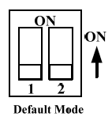
DIP Switch & 4 Working Modes
On the back of MT4000/5000 series, there is a little cover, remove the cover, users could see the DIP switches, which is for setting HMI in different working modes. The corresponding working modes of the setting are as follows:
SW1 | SW2 | Working mode
OFF | OFF | Normal Working Mode
ON | OFF | Firmware Update Mode
OFF | ON | Touch Screen Calibrate Mode
ON | ON | System Setting Mode

Slide 10
Ⅱ. Kinco HMIware Fast Start
Ⅱ. HMIware Fast Start

Slide 11
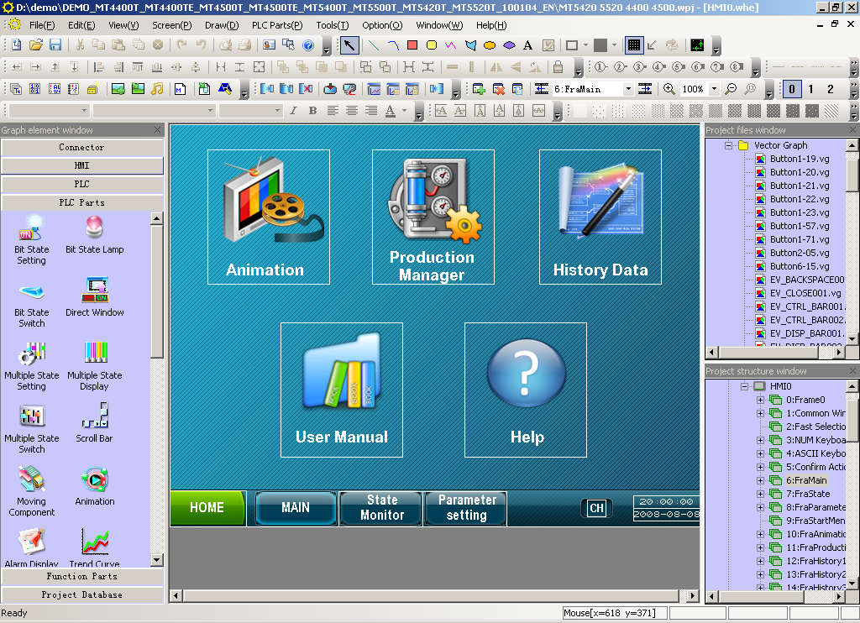
Kinco HMIware Introduction
Kinco HMIware is configuration software for MT4000/5000 series. The software for MD200/300 is TP200 and TP300 respectively, which are very simple, we will only introduce HMIware.

Slide 12
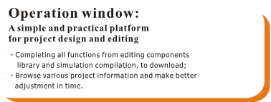
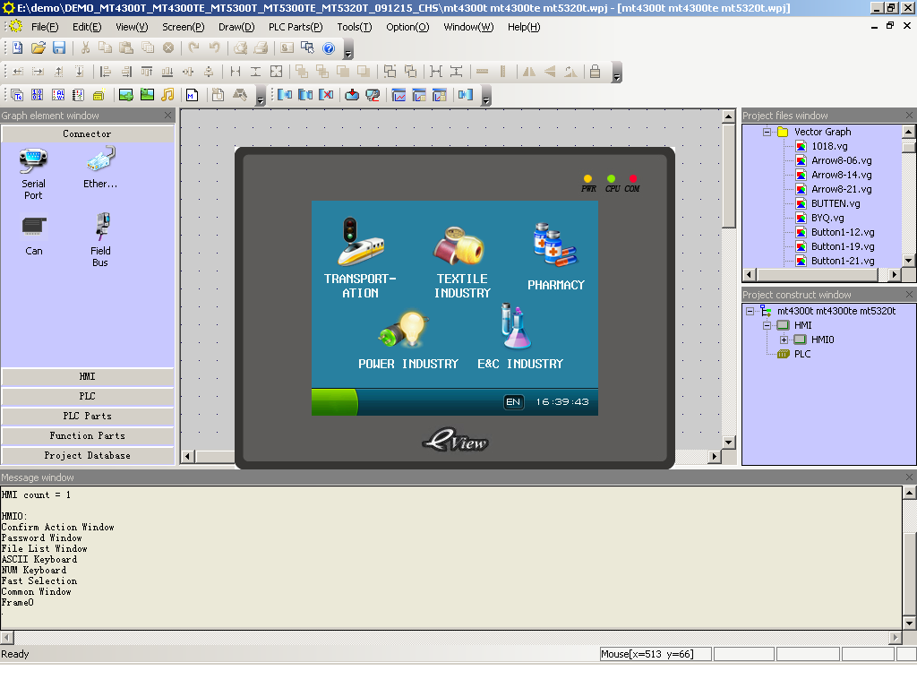
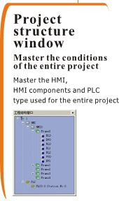
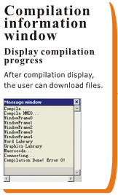
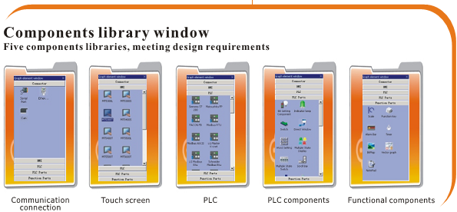
HMIware Interface Layout

Slide 13
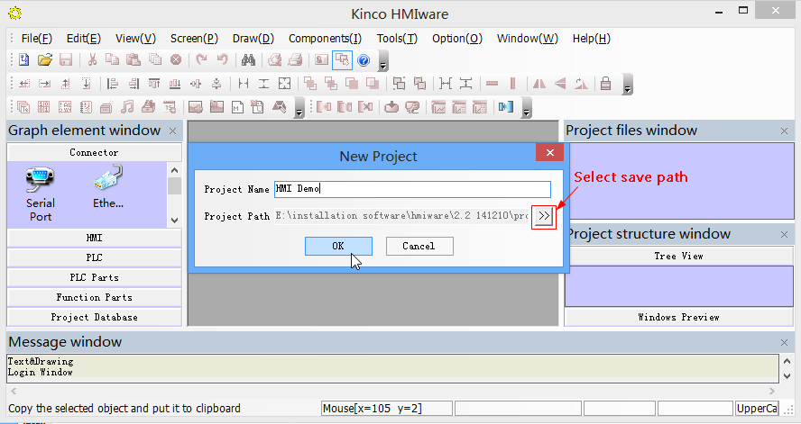
Steps to Create New Project
Step 1:[File]-[New], then I will pop “New Project” dialog box. Input project name ,select save path and press [OK] to create new project. Then it will popup gray grid working area named “Construct Window”.

Slide 14
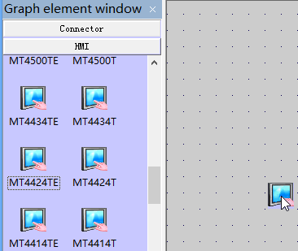
Steps to Create New Project
Step 2: Select HMI model in [Graph element window]-[HMI], and drag it into the project construct window. After you place the selected model in the editing area, the “Display Mode” dialog box will pop up. Select display mode as Horizontal or Vertical and press [OK].
In the same way, select PLC model in [Graph element window]-[PLC], and drag it into the project construct window.

Slide 15
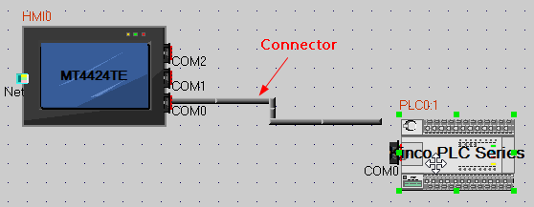
Steps to Create New Project
Step 4: Select connection between HMI and PLC in [Graph element window]-[Connector], and drag it into the project construct window.
Step 5: Drag HMI icon to make “COM” port to approach to one side of connector until the connector moving together with HMI. Then connect PLC to Connect PLC to another side of the connector in the same way. After connecting, drag the HMI or PLC to check whether the connection is firm.

Slide 16
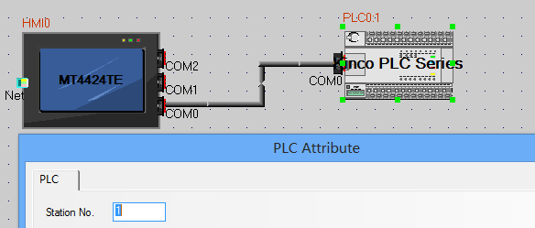
Steps to Create New Project
Step 6: Attributes setting
Double click on the HMI or PLC, it will pop up window of [HMI Attribute] or [PLC Attribute];
Then enter to each page of the attribute window to set corresponding parameters:
PLC: Station No..
HMI: Task Bar, HMI Extended Attributes, COM0 Setting, COM2 Setting …

Slide 17
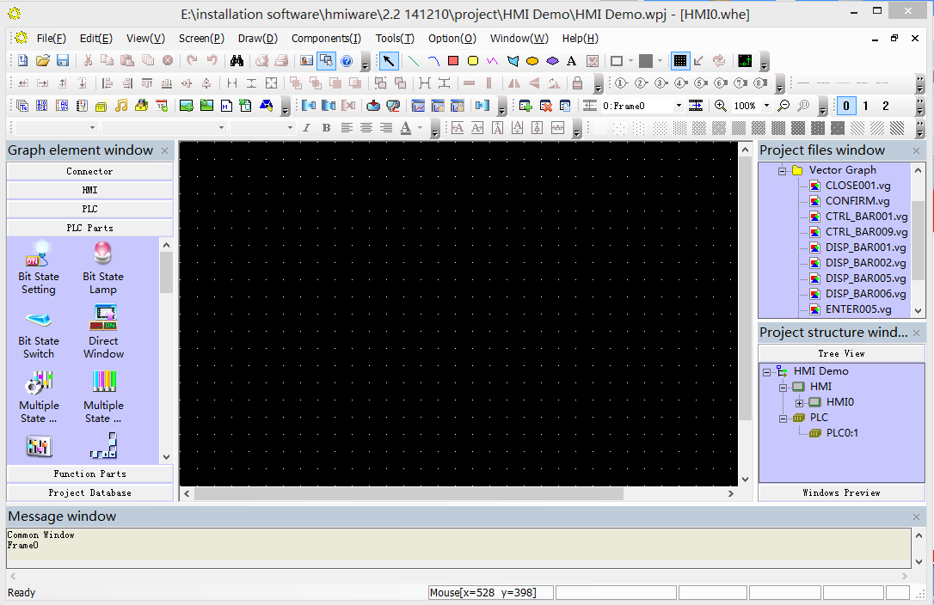
Steps to Create New Project
Step 7. Edit Frame
Open HMI Edit Window by the following ways:
Right click HMI icon, and click “Edit” in the popup menu;
Select in menu bar [Window]-[HMI Edit Window]

Slide 18
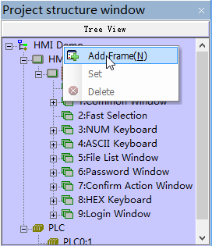
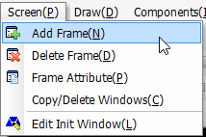
Steps to Create New Project
After open the HMI Edit Frame, system will create frame 0~9 automatically. Frame 1~9 are specified system windows. Frame 0 can be used freely by user. Also users could add new frame for programming:
Click the icon on toolbar;
Select in menu bar [Screen]-[Add Frame] command;
Right click on the project name in Project structure window and select “Add Frame”.

Slide 19
Steps to Create New Project
Step 8. Save project
click the icon in Basic Toolbar to save the project.
Step 9. Compile & Simulate project
After finishing the programming, users could click the icon in System Toolbar to compile the project firstly. After compilation succeed, user could click the icon to offline simulate the project.
Step 10. Download project
The procedure of downloading project is as follows:
Choose download way by click the icon in System Toolbar to open the dialog box of [Project Setting Option].
Select one download way: USB, Ethernet, Com are selectable. And ensure the corresponding parameter settings are correct.
Click the icon in System Toolbar to popup the dialog box of [KHDownload], select the options for download and press [Download].

Slide 20
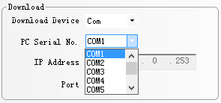
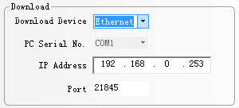
Steps to Create New Project
Note: Communication parameter setting for Downloading:
Download way | Parameter setting
Download via USB port | No need to set communication parameters. Note: Download via USB for the first time, users need to install the USB driver
Download via serial port | Choose the current used serial port No.:
Download via network | Set IP address and port number of the current HMI:

Slide 21
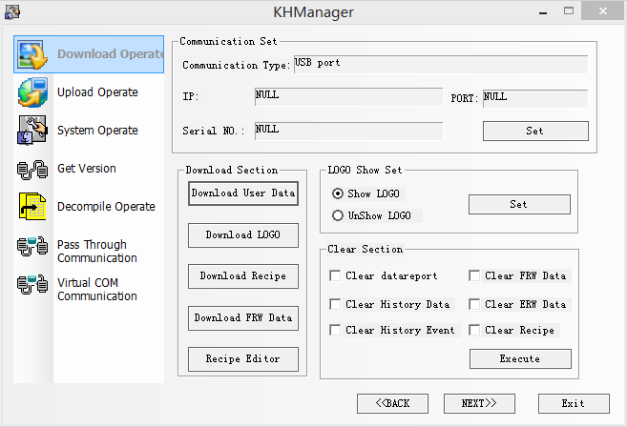
KHManager
KHManager is for some system operations, which consists of six processing modules: Download, Upload, System Operation, Get Version, Decompile Operation, Pass Through Communication.

Slide 22
Simulation
Kinco HMIware supports 3 modes of simulation: Offline simulation, Indirect online simulation, Direct online simulation. The three modes of simulation could help user debugging program.
Name | PLC/Controller | HMI | Description
Offline simulation | - | - | No need to connect with PLC or HMI. The program cannot acquire data from PLC, only read data from local address. Therefore all data displayed on the configuration windows are static data.
Indirect online simulation | √ | √ | Need to connect PLC and HMI. PLC data can be obtained dynamically. The operating is the same as downloaded into HMI, but does not need to download program into HMI.
Direct online simulation | √ | - | Only connect PLC, PLC data can be obtained dynamically. This mode is used to check whether communication is normal without connecting with an HMI. Test time 15minutes.

Slide 23
Ⅲ. Main Function Introduction

Slide 24
Main Functions Introduction
Main functions of HMI are as follows:
Display and control bit status
Set and display data
Monitor the data curves
Display Alarm Information
Show animation
Store parameters in HMI
…
All the functions can be realized by programming by the components of HMIware software. We will introduce common used components of HMIware in following.

Slide 25
Button/Switch/Lamp Components
Bit State Setting: it is a switch without lamp, used to control bit register without display the state of the bit register.
Bit State Lamp: It is used to indicate the state (0/1) of the bit registers in HMI or PLC. It can display tag text and graphic.
Bit State Switch: It is a combination of Bit State Lamp and Bit State Setting component. It is used to control bit register of Write Address and display the state of bit register of Read Address. Read Address and Write Address can be the same or not.

Slide 26
Button/Switch/Lamp Components
Multiple State Setting: It is used to write a value to a specified register in HMI or PLC. It has no registers for reading display states.
Multiple State Display: It is used to display mapping state according to the value in the specified registers. Up to 256 states are supported.
Multiple State Switch: It is the combination of Multiple State Display and Multiple State Setting components. It display status according to the value of Read Address. Meanwhile it could write mapping value to Write Address. Read Address and Write Address can be the same or not.

Slide 27
Number/Text Components
Number Input: It is used to set and display the data into word registers.
Number Display: It is used to display data of word registers.
Text Input: It is used to set and display value into word registers in ASCII format.
Text Display: It is used to display value of word registers in ASCII format.
Note Book: It is for write and character strings into HMI/PLC registers in ASCII format. Meanwhile display the data in ASCII format.

Slide 28
Graph/Meter Components
Trend curve: It is used to display the trend curve of data.
Oscillograph: It is similar to trend curve, but there is some difference between it and trend curve. It can not work in the background and it can not save.
XY Plot: It is used to display the curve of the relationship between two variables
Bar Picture: Display percentage of actual value of HMI/PLC registers comparing to the set maximum/minimum value.
Meter: Display the data of HMI/PLC registers in instrument chart.

Slide 29
Event/Alarm Components
Alarm Information: It is used to login alarm information in HMI.
Alarm Display: It is only display the current triggering alarm logined in “Alarm Information List”. Alarm information will be removed when alarm condition is cleared. Alarm information can’t be saved after power off.
Alarm Bar: It display and roll the current triggering alarm logined in “Alarm Information List”. It is similar to the advertisement in neon lamp.

Slide 30
Event/Alarm Components
Event Information: It is used to login event information in HMI.
Event Display: It display triggered and currently triggering event . Event information can be saved in HMI internal memory, Pen drive or SD card.
Event Bar: It is the same as Alarm Bar.
Historical Event Display: It display the event information when event happen. And the event have to be set to save in external memory. What’s more it support query function.

Slide 31
Graphics Components
Import Graph library: It is used to import bitmap and vector graph library into HMI.
New Graph: This is used to create new bitmap and vector graph. And make the graph by yourself.
Bitmap: It is used to display bitmap picture.
Vector Graph: It is used to display vector picture.

Slide 32
Data Transfer Components
Recipe Data: Recipe Data component is used to transmit HMI data that stored after power off to specified PLC/HMI registers, or transmit data in PLC/HMI to HMI registers so as to be stored after power off.
Data Transmission: It is used to transfer data from specified registers to other registers. It can transfer values of 32767 registers at one time.
Timer: Timer is very useful for circular process. Timer could be used to execute macro, transfer data, and set values to assigned registers.

Slide 33
Window Components
Direct Window: It is to use a bit state register as a alarm to control the popup window. The pop up window is decided by the Direct window size. One direct window can only popup a constant window.
Indirect Window: It is similar to direct window. But it is control by a data register. Input window’s number to pop up the assigned window. The pop up window is decided by the Direct window size.
Function Key: It is used to popup basic window by manual. It need to push the button to popup window. Function key has many other functions.

Slide 34
Animation Components
Bit States Neon Lamp: It is used to display tags as a neon lamp circularly . It is controlled by bit register.
Multiple State Neon Lamp: It is used to display up to 256 tags as a neon lamp circularly . It is controlled by data register.
Moving Component: It is used to move the component by change the position of X axis and Y axis.
Animation: It is used to move the component through the route that you set in advanced.
Dynamic Graph: It is used to change the position and size of rectangle, ellipse or straight line.

Slide 35
Grid&Table
Grid: It is used to write the column number and row number into the specified HMI/PLC registers. The grid can be selected in row, column, or cell.
Operation Log: It is used to record the operation what the user do on the HMI and save the information in the external memory(USB disk or SD Card).
User info display: It is used to display the information about all the users set in user permissions. It must be used together with user permissions use
separately is invalid.
Historical Data Display. It is used to sampling data and save data into internal memory or extended memory. It displays data as a table and can be query by sequence No. or date.

Slide 36
Data Report/Curve
Datalogger: It is used to sample data and set sampling method, these data can be displayed on Data Report or Data Curve.
Data Report : It is used to display data that is logged in Datalogger and stored in external memory device on the HMI in report. The logged registers can be continuous or discontinuous registers.
Data Curve: It is used to display data that is logged in Datalogger and stored in external memory device on the HMI in curves. The logged registers can be continuous or discontinuous registers.

Slide 37
Data Report/Curve
Report Mode | Supported Report Type | Note
Real time: Update report data timely according to the settings. | Trig report | User define sampling cycle or trigger sampling by register, then get the instant data on real time.
 | Free report | Display data in user defined time interval: minute/hour
 | Daily report | Display data of one day.
History: Input the time range to query the historical report. | Trig report | As above.
 | Free report | As above.
 | Daily report | As above.
 | Monthly report | Display data of one month.
 | Quarterly report | Display data of three month.
 | Annual report | Display data of a year.

Slide 38
Auxiliary Components
Scale: It is used to set equal scale label for some components, like bar picture, meter and so on.
Scroll Bar: It is used to change the value of HMI/PLC register by moving slider. Scaling relation between actual value and Min/Max is dislayed by the position of slider. Usually used together with table or curve components.
Data/Time: It is used to display HMI system data and time in specified format.
File List: It is used to display the file information in external memory device. It is a special component, usually used together with Import/Export function of Function Key.

Slide 39
Auxiliary Components
Trigger Touch: It is used to trigger multiple components without touching them. When the specified address satisfies the setting Trigger Type condition, all the components in the Trigger Touch area will be triggered.

Slide 40
Ⅳ. Advanced Function Introduction

Slide 41
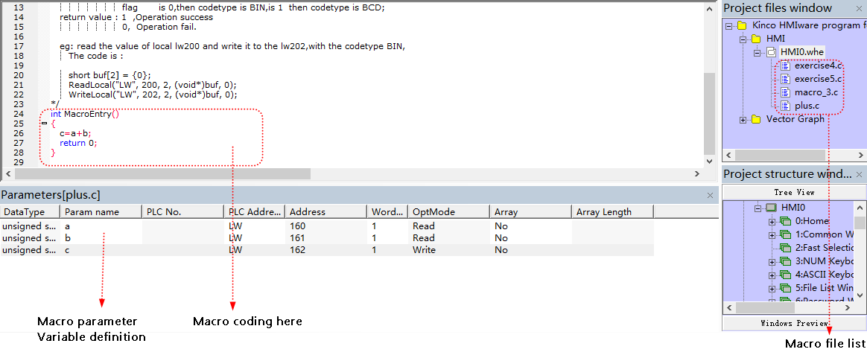
Macro
The HMIware macro supports standard C language. Users could use macro and other components together to realize complex arithmetical operation.
Create macro by the icon on the basic toolbar. Then the macro edit window will pop up:

Slide 42
Macro
For macro coding, users need to define variables then use the assigned names in program.
Call macro
There are many ways for calling macro:
Function key
Timer
PLC Control
Event
Notification
HMI system start

Slide 43
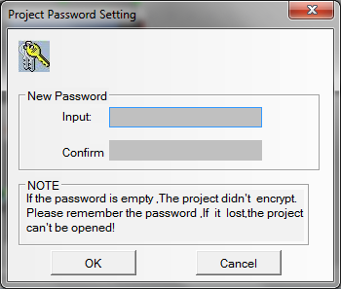
Password Protection
HMIware provides powerful password protection for users to ensure security of user’s intellectual property. Mainly the passwords are used for project protection, window protection, and important component protection.
Project protection
Password for uploading project from HMI.
Password for decompiling the file(.pkg) which uploaded from HMI.
Password for downloading project.
Password for opening the project file (.wpj).

Slide 44
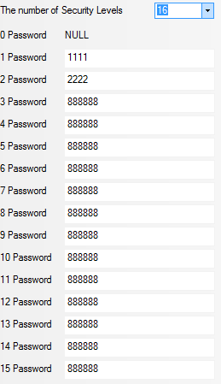
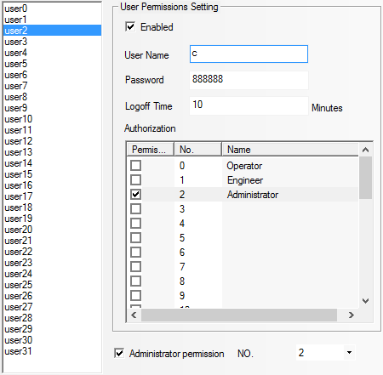
Password Protection
Component protection
To avoid disoperation, users could set user permissions and security levels to require password for operation. 32 user permissions and 16 security levels are settable.

Slide 45
Password Protection
Window protection
It is similar with component protection, but only support security level.

Slide 46
Insight into Database
In HMIware, users can put the repeat information or background function in database components, then it is easy to control and call the information and function, and reduce data redundancy. Alarm information list/event information list/Datalogger are already referred in above, we will introduce the rest parts.
Text Library: It is used to store the text content in the project, so that users no need to input same text tag repeatedly. Text Library support up to 32 kind of languages and users could switch display languages
Address Tag: It is used to assign names to addresses to easy to remember.
Sound Lib: It is used to import sound files such as WAV, MP3 format. Then the sound could be used for touch sound or event/alarm sound.

Slide 47
Insight into Database
Schedule List: It is used to configure the operations which will be execute in specific time.
PLC Control: It is used to log in the trigger condition of some functions, when specified register satisfies the setting condition, the corresponding function will be executed.
Main functions for PLC Control:
Change window
Write data to PLC (when switching basic window, write window number to specified register)
Execute macro
Report Printout (Print current screen)
Screen hard copy (Screens hoot)
General PLC control(Data transmit)

Slide 48
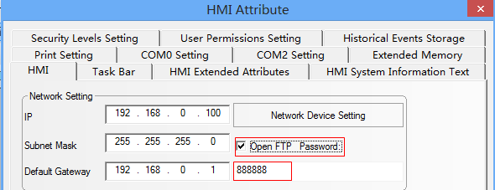
FTP Function
FTP function is used to transport files of external storage device to PC via LAN, or transport files of PC to external storage device. So the FTP function is only available for HMI with USB HOST or SD card and Ethernet port.
Steps to set parameters for FTP function:
Step 1: In [HMI Attributes]-[HMI], set [Open FTP] and set password.

Slide 49
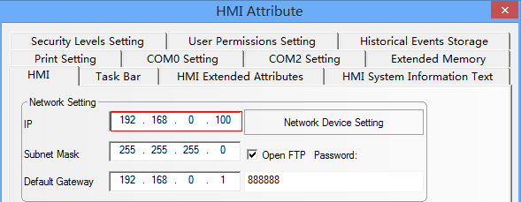
FTP Function
Step 2: In [HMI Attributes]-[HMI], set IP address of the current HMI, and not modify the subnet mask and the default gateway.
Step 3: Save, compile, then download the project.

Slide 50
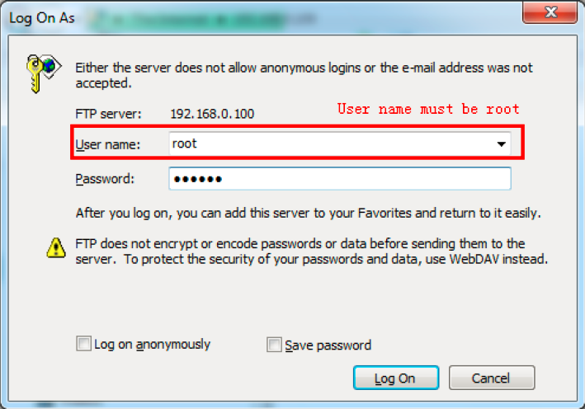
FTP Function
Step 4: Use crossed or straight-through cable via Hub or Switch to access the HMI LAN. In the address bar of browser or Explorer, enter: ftp://192.168.0.100. Then the system will automatically pop up the following dialog. Enter user name: root, password:888888, then users can log into FTP server.

Slide 51
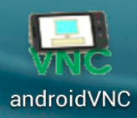
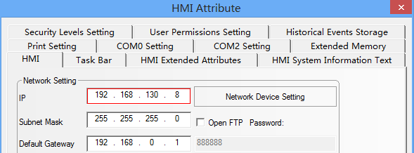
VNC Function
Users could use the VNC system to remote control HMI via PC, mobile and so on. Only the HMI models with Ethernet port support VNC function.
Steps to set parameter for VNC function:
Step 1: Install the VNC software on PC or on mobile. Also users could access HMI via browser or explorer.
Step 2. Set IP of HMI, and take the Subnet Mask and Gateway by default:

Slide 52
VNC Function
Users could use the VNC system to remote control HMI via PC, mobile and so on. Only the HMI models with Ethernet port support VNC function.
Steps to set parameter for VNC function:
Step 1: Install the VNC software on PC or on mobile. Also users could access HMI by browser or explorer.
Step 2. Set IP of HMI, and take the Subnet Mask and Gateway by default:

Slide 53
VNC Function
Step 3: There are some system registers of HMI for VNC function. Users need to add the registers on HMI frame.
Register | Function
LB9290 | Open VNC function. Set to “1” to open the VNC function.
LB9291 | Mask user operation. Set to “1” to mask user operation (monitor only, cannot operate)
LB9292 | Operation password enable. Set to “1” to enable operation password.
LB9293 | Inquiry password enable. Set to “1” to enable operation password.
LW10146~LW10147 | Operation password
LW10148~LW10149 | Inquiry password
Step 4: save, compile, download the project.

Slide 54
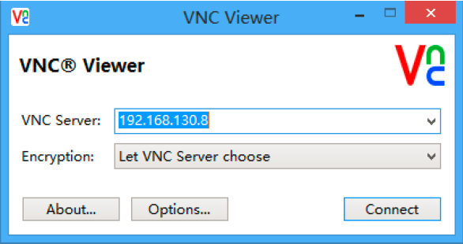
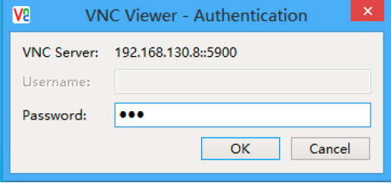
VNC Function
Step 4: Access HMI via LAN
Access HMI by NVC viewer on PC: Input HMI IP and the inquiry or operation password, then the HMI frame will display. (No need to input password, if users do not set any password.)

Slide 55
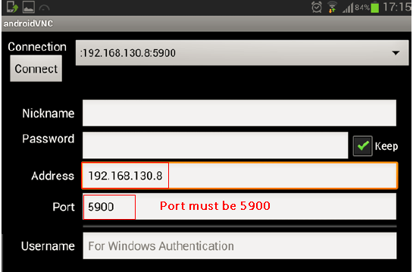
VNC Function
Access HMI by androidNVC on mobile is similar with access HMI by VNC viewer on PC.

Slide 56
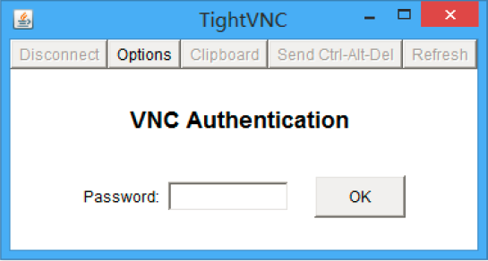
VNC Function
Access HMI by browser: open the browser, input IP and port of the target HMI in the website box: http://192.168.130.8:5800. Then the following dialog box will pop up, input password to access HMI frame. (No need to input password, if users do not set any password.)
Note: The port must be set to 5800 when access HMI by browser.

Slide 57
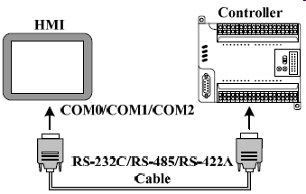
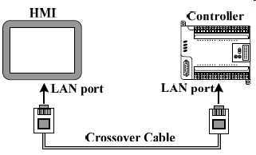
Communication
Kinco HMI supports various communication ways: Serial port, Ethernet port, field bus.
Single HMI with single PLC via serial port
Single HMI with single PLC via Ethernet port

Slide 58
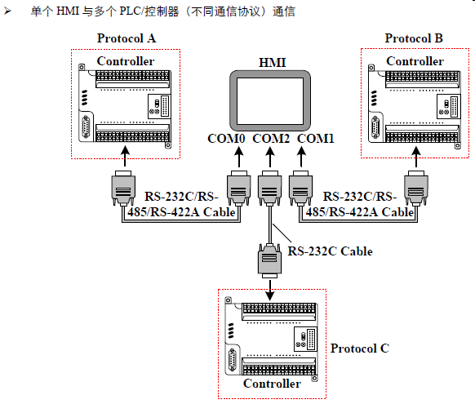
Communication
Single HMI with multiple PLCs via serial port: different protocol

Slide 59
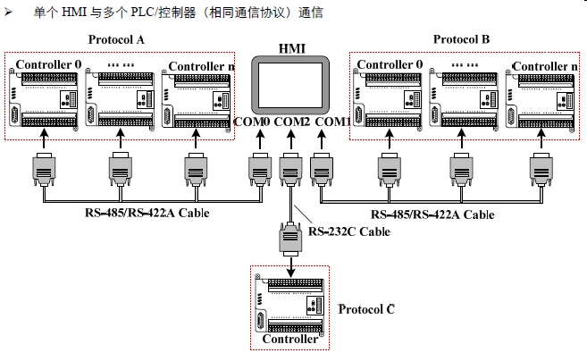
Communication
Single HMI with multiple PLCs via serial port: same protocol

Slide 60
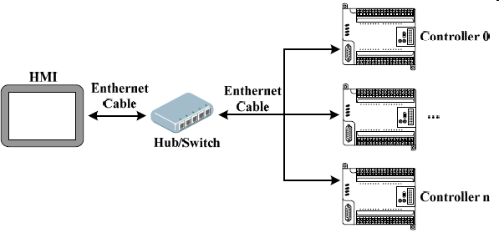
Communication
Single HMI with multiple PLCs via Ethernet port

Slide 61
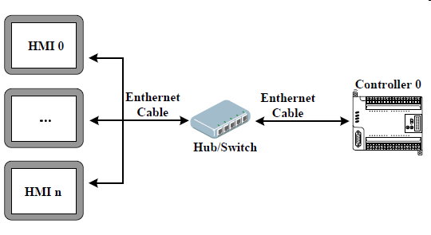
Communication
Multiple HMI with single PLC via serial port

Slide 62
Communication
Please note PLC driver selection when MODBUS RTU protocol is used for communication:
For communication via MODBUS RTU, HMI works as Master:
For communication via MODBUS RTU, HMI works as Slave:

Slide 63
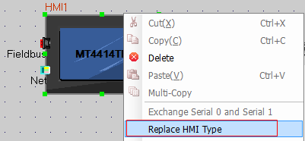
Tips for HMIware Programming
Replace HMI Type:
In the application, users need to change to new HMI models, but keep the PLC model, then user could replace HMI type, and download the original project. No need to reprogram.
Align toolbar for component or tag arrangement

Slide 64
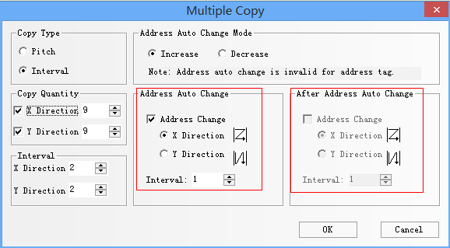
Tips for HMIware Programming
Multiple copy & address auto change
It is very useful for components with continuous address and same settings
Common window& Bottom window
Multiple frames share with same titles, tags and other same components, users could use common window and bottom window to shorten program time.

Slide 65
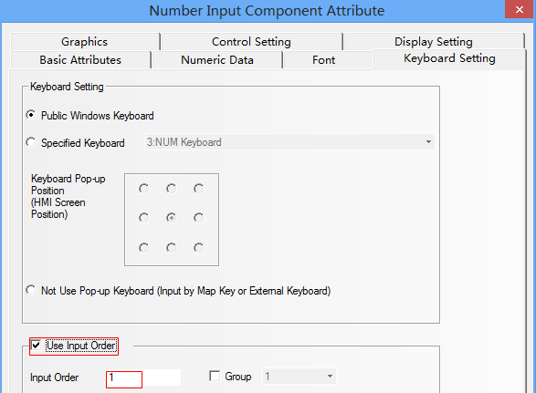
Tips for HMIware Programming
Input Order
By setting input order, users could input the component continuously when the keyboard pop up. The keyboard will not be closed when press ENTER during inputting. The input cursor will flash in cycle among components that set with input order. Click the close button to close the keyboard.

Slide 66
Exercises
Add a frame for switch 3 languages by using text library;
Add a frame, select ”Group 1, Group 2, Group 3” by drop list, each group correspond to a frame;
Realize the following by macro: when M10.1 and M10.2 are both 1, VW4=5;
When M10.1=0, or M10.2=0, vw4=8;
4. Put a number display component, and set its value increasing from 0~5000 by 1 periodically. When its value is interger times of 100, then the alarm buzzer ring for 3s.
5. Set 5 group of values to VW10~VW18 by recipe.
6. Sample on VW20~VW22, and display the sampled values in Data report: Real time- Free report.

Slide 67
Thank you !

